Slide 1


PNNL Team
Milestone 4
Thursday | April 22 2021

Slide 2

Presentation agenda:
Stories/Progress (Burndown Chart)
System Design
Database
Devops/Cost Report Update
CHISSL + Model Data Pipeline
Backend APIs
User Interface (Demo)
Handoff Materials

Slide 3
Medium Priority User Stories
Convenience
Flexibility
Readability
As a PM, I’d like the services to be containerized to make it more convenient for setting up after handoff
As a PM, I’d like to see that the services are less AWS dependent in case that we decide not to use AWS
As a building operator, I’d like the clear fonts such as Times New Roman so information is easy to read

Slide 4
High Priority User Stories
Machine Learning
Cost
Timeliness
As a PM, I’d like to see the cost report to anticipate how much investment is needed for future use
As a PM, I’d like the system design to include machine learning, so that building operators could view abnormal events identified by the ML model
As a building operator, it is important to see the data in a timely manner to make decisions on the operating units within the building

Slide 5
High Priority User Stories
Notifications
Design
Visualizations
As a building operator, I’d like some sort of notification to let me know about issues I need to be aware of in the building
As a PM, I’d like to see that it is designed with simplicity with added technologies justified so that we avoid unnecessary complexity
As a research scientist, I would like to see various visualizations of aggregated CHISSL labelled data

Slide 6
Overall Progress
Utilized CHISSL to develop machine learning models tailored to client input
Created zone temperature and zone airflow visualizations based on the predictions created from the model
Displayed real-time data using Grafana Dashboards
Added the Alert Service and displayed the information on the web application
Developed and tested and deployed Airflow to run the predictions daily
Developed a frontend react application emphasizing on readability and robustness upon ml model changes
Developed documentation and packaged the code in GitHub

Slide 7
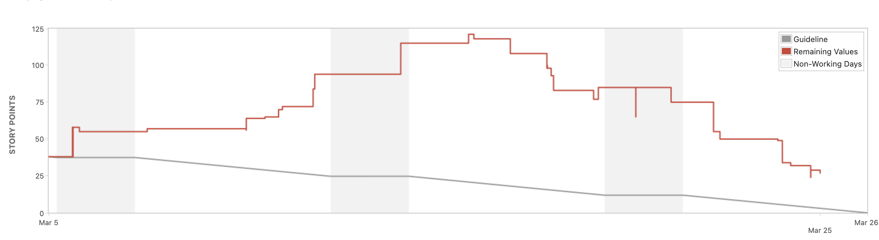
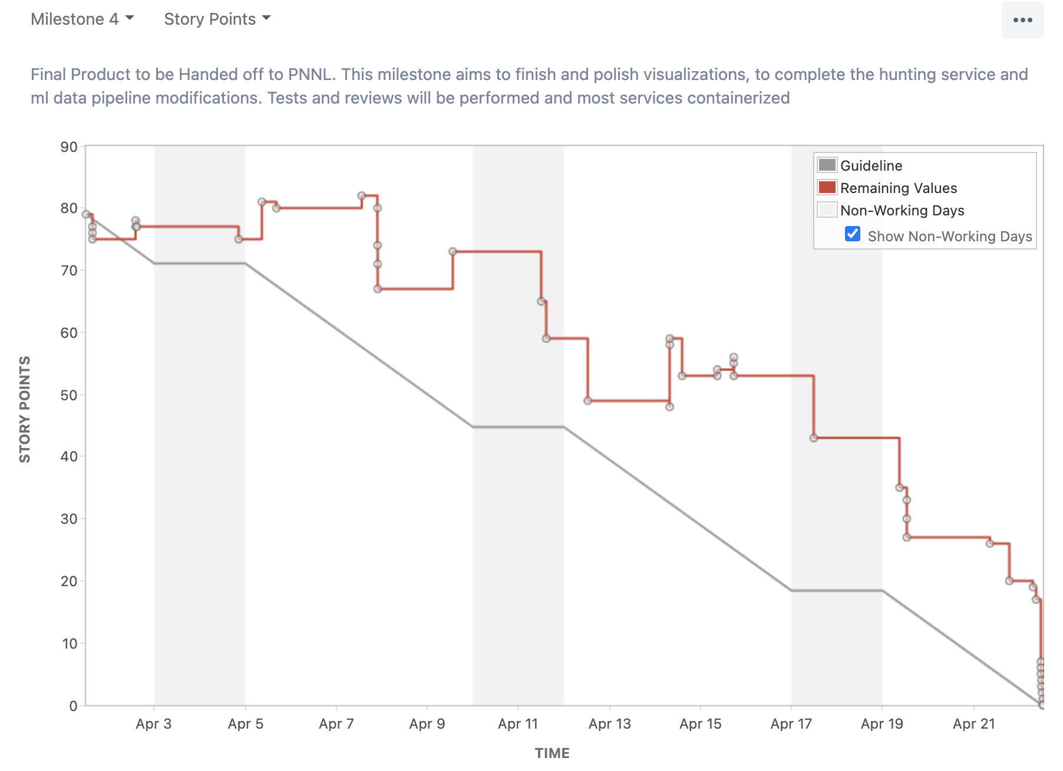
Burndown Chart
Above: Milestone 3 Left: Milestone 4

Slide 8
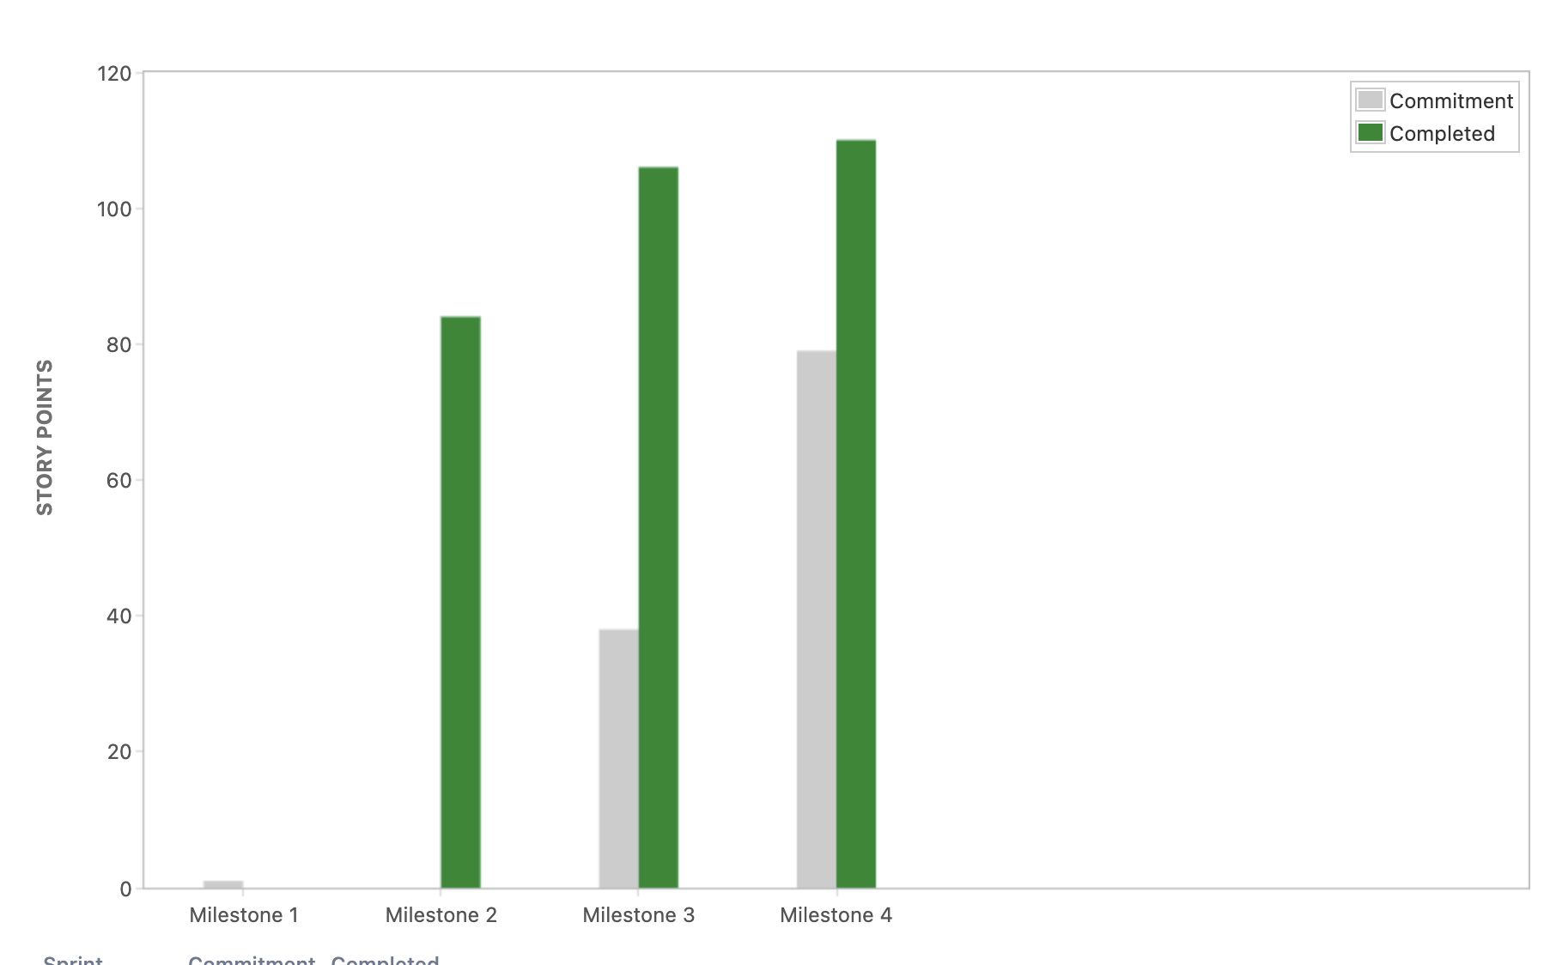
Velocity Chart
We see to the right that the team progressively increased the number of story points across milestones

Slide 9

System Design

Slide 10
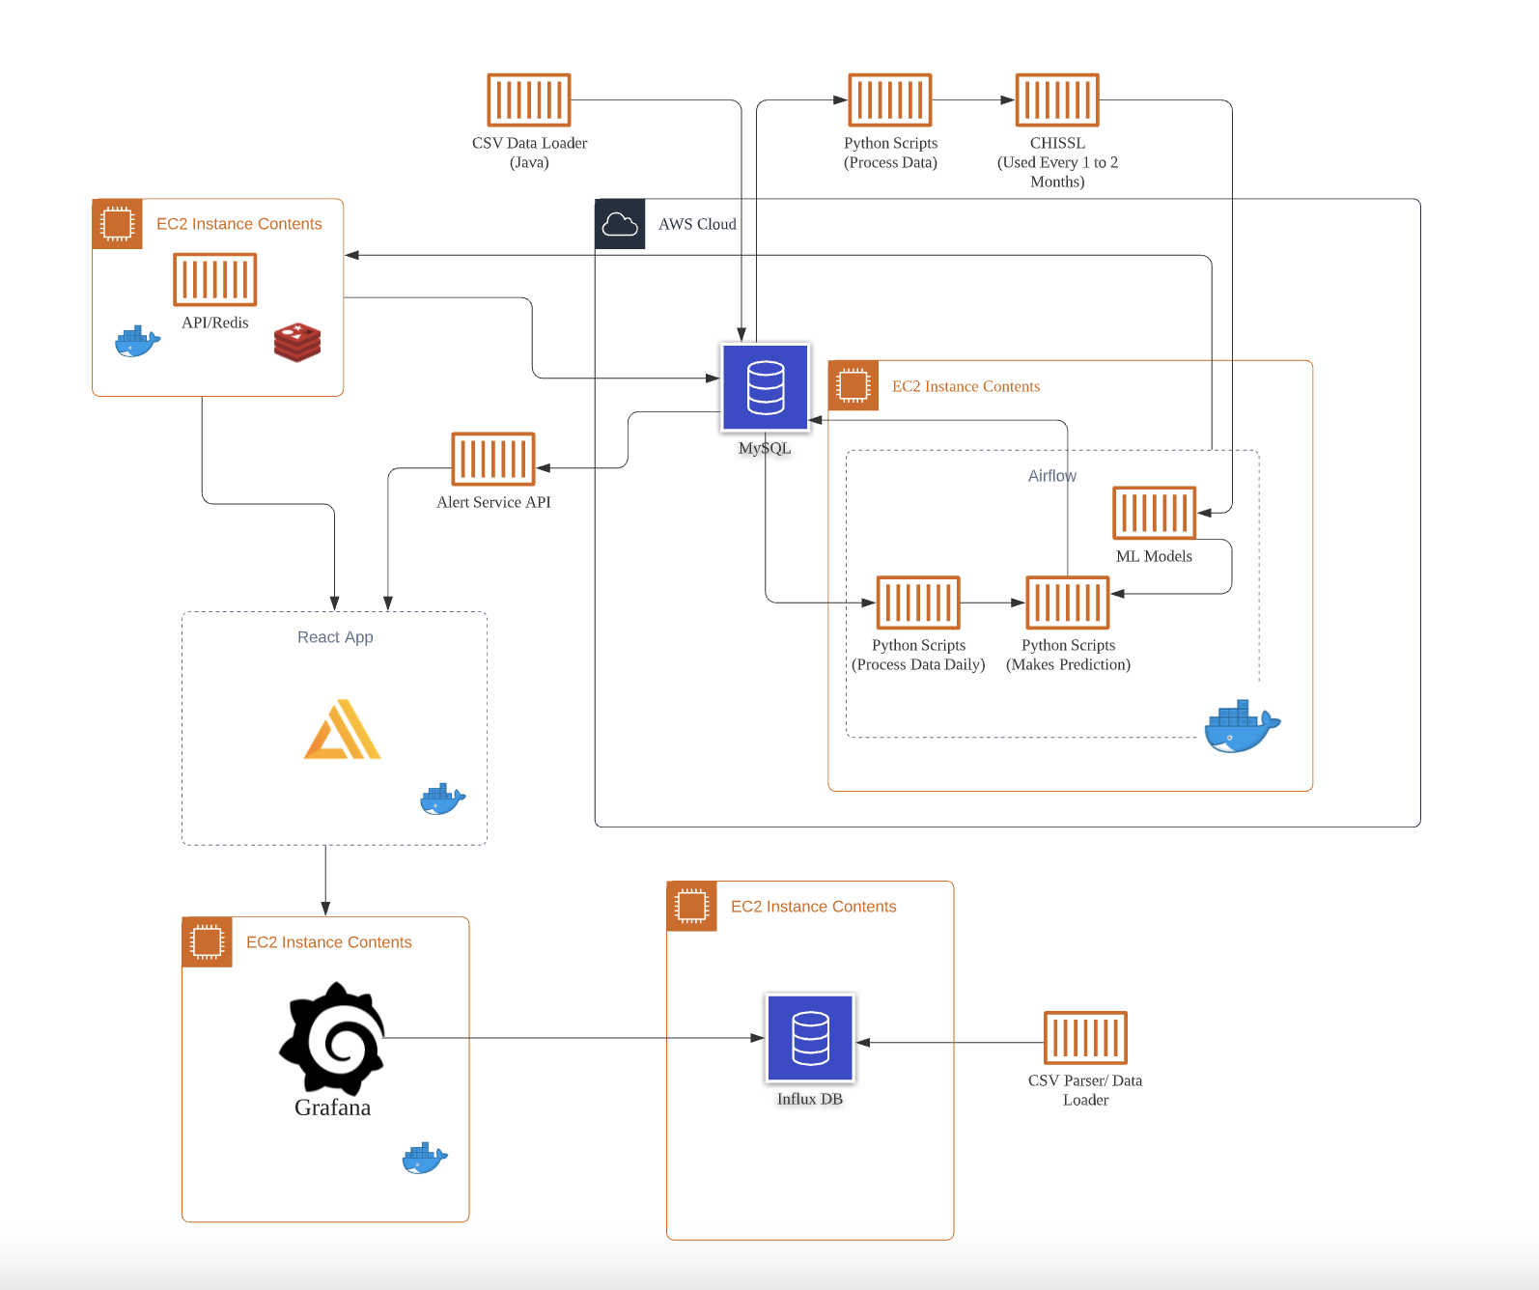
System Design

Slide 11
Database

Slide 12
Database
Machine Learning
MySQL
Timestamps are shifted to simulate live data
Denormalized
CVS import
Used in the ML workflow
Labeled Agg
One table per metric (airflow & temp)
Stores the aggregated labeled data
Normalized
Data are organized in a relational DB structure
Used in hunting service
As a PM, I’d like the system design to include machine learning, so that building operators could view abnormal events identified by the ML model
Notifications
As a building operator, I’d like some sort of notification to let me know about issues I need to be aware of in the building
Timeliness
As a building operator, it is important to see the data in a timely manner to make decisions on the building operations

Slide 13
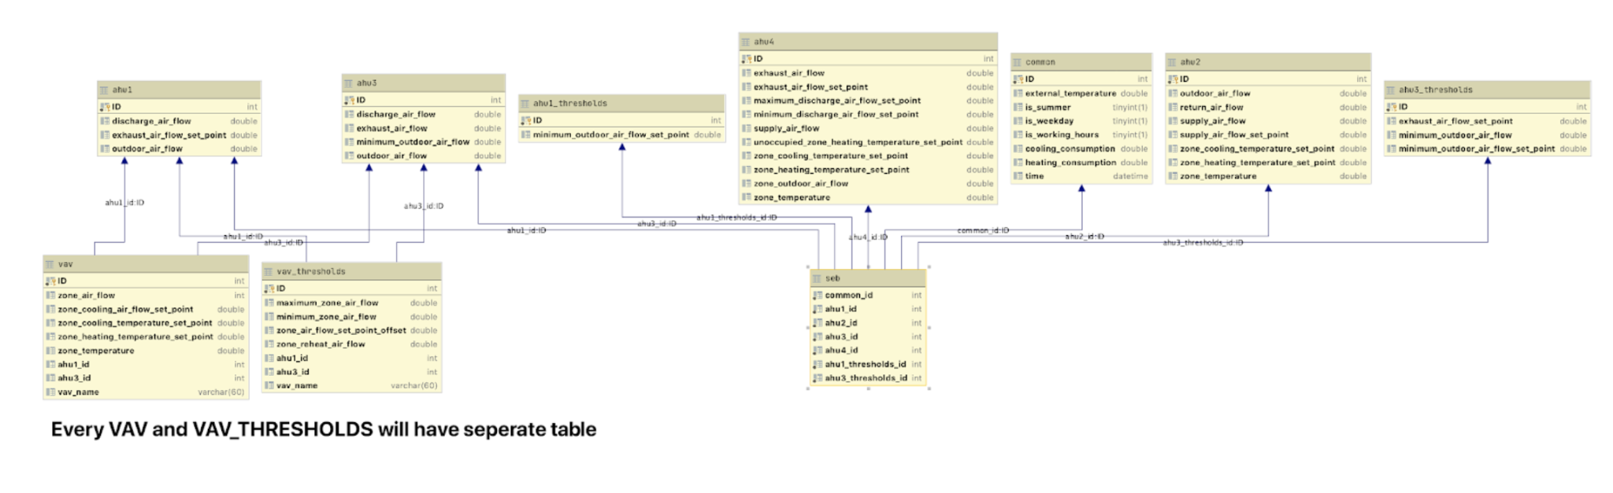
Database
Normalized CSV Schema

Slide 14
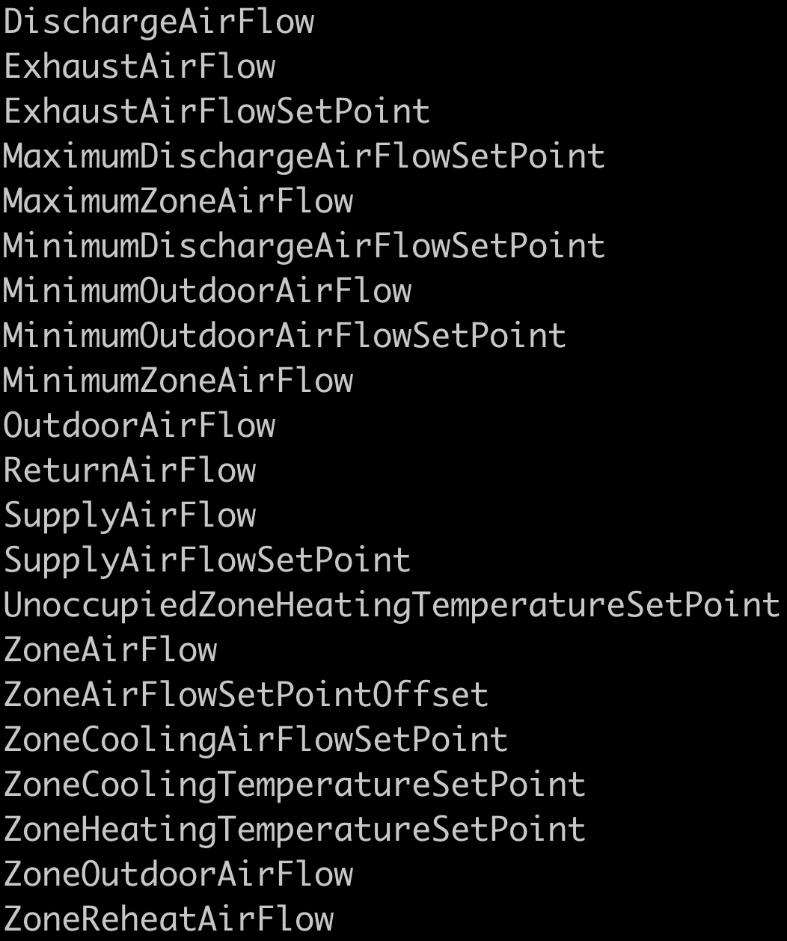
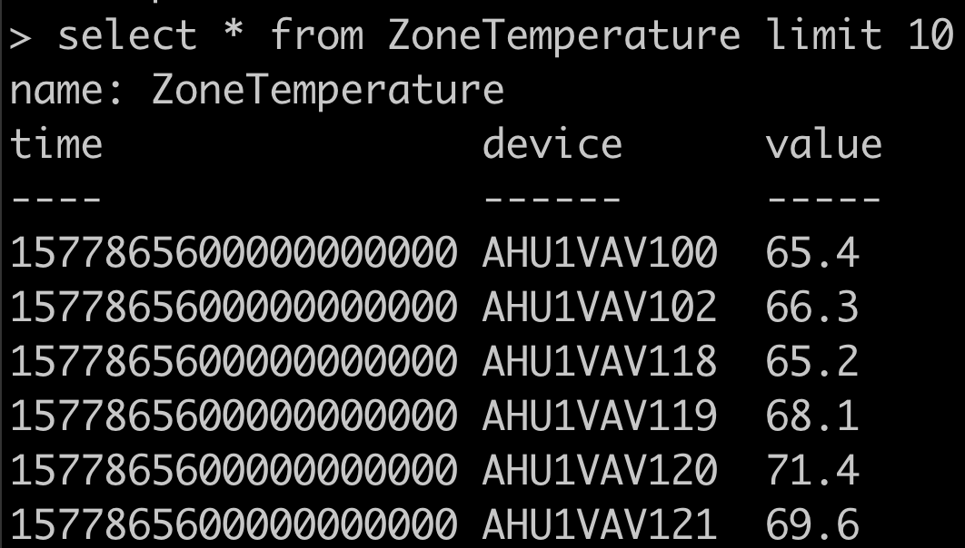
Database
InfluxDB
Time Series DB used to display data in real time

Slide 15

Devops

Slide 16
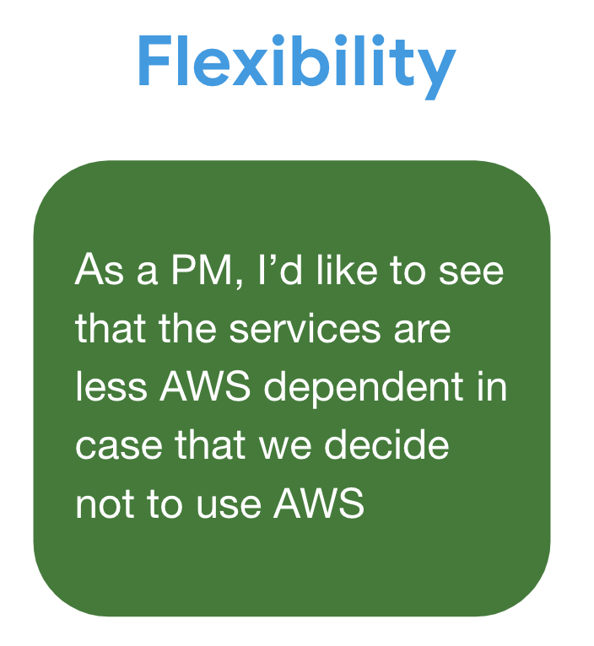
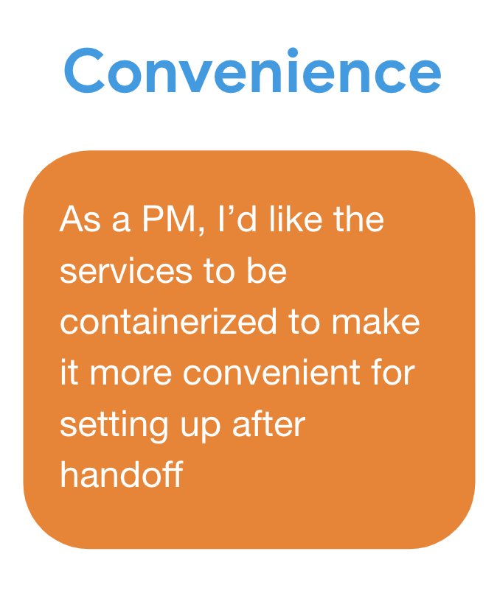
Devops
Machine Learning
As a PM, I’d like the system design to include machine learning, so that building operators could view abnormal events identified by the ML model

Slide 17
Devops
Cost Report
The cost report was generated for the previous milestone for deploying the services in AWS.

Slide 18
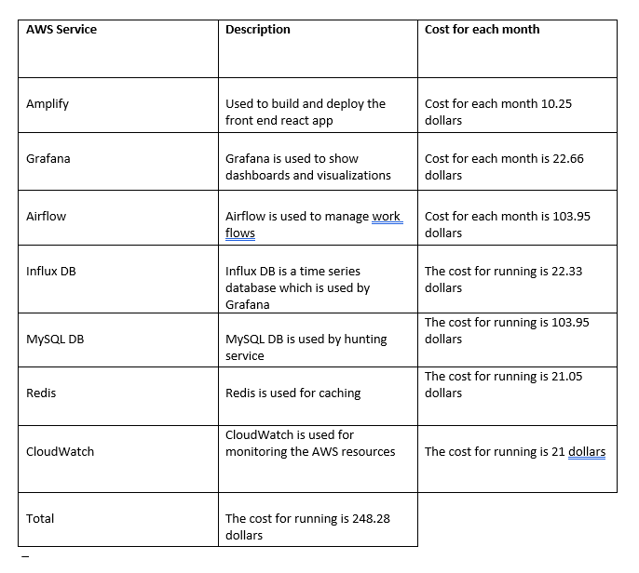
Breakdown of Cost Report
The breakdown of cost from Milestone 3 for deploying Services in AWS.

Slide 19
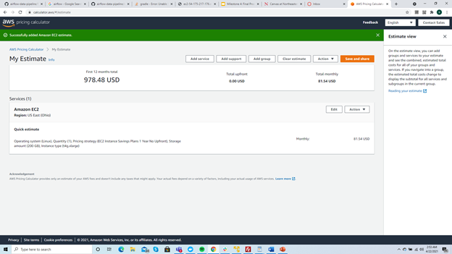
Breakdown of cost for Docker Resources
The cost for deploying all the services as docker images in an EC2 instance with 16 GB RAM and 200 GB space is

Slide 20
Grafana Docker Container
The grafana docker container is based on ubuntu image
The grafana version 7.5.3 is used
The configuration can be changed before running the Docker image
After the grafana dashboard is up the end points have to be configured and dashboards have to be imported
The grafana container is tied with InfluxDB container in docker-compose to provide easier deployment

Slide 21
Hunting Service Docker Container
The Hunting Service is used by the frontend to create alerts
The Hunting Service is based on ubuntu image
The hunting service uses java 14
The timezone of the hunting service container is set to EST.
The url of the database , username and the password for the database can be changed while running the container
The hunting service container is deployed with front end react app container in docker-compose for easier deployment

Slide 22
Airflow Installation Scripts
Airflow is an open source workload management system. We install airflow using docker images.
We require docker installed on the system and sudo access.
The documentation to install airflow can be found at
https://github.com/PNNL-Project/airflow-data-pipeline/tree/master/airflow

Slide 23
InfluxDB data import and containerization
InfluxDB share the same data source with MySQL but it has a very different schema
Scheme:
Export MySQL denormalized table -> .csv file -> InfluxDB parser (written in Java) -> split .csv file to multiple files (each file is for one measurement) -> another python script import these files into influxDB
InfluxDB is containerized using existing image on Docker repo. The data is loaded externally from previous backup data.

Slide 24
AWS Amplify
To facilitate our development & testing procedure, we hosted our frontend react app onto AWS Amplify.
Read main branch from specified Github repo.
Observe the changes after push.
Used during development only, it will not be transferred to clients.

Slide 25
React App Containerization
One frontend app (previously hosted on Amplify)
Two backend apps:
1) Hunting service (Spring framework, jar file)
2) Predictions service (redis, node js express server, cron job)
Highly related services -- docker compose for simple deployment
It can hosted in different machines if needed (Dockerfile available for individual service)

Slide 26
Demo: Grafana service + React front end

Slide 27
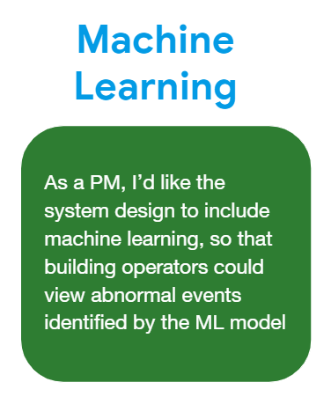
Sprint 3 Backend Architecture
Visualizations
Notifications
Design
As a building operator, I’d like some sort of notification to let me know about issues I need to be aware of in the building
As a PM, I’d like to see that it is designed with simplicity with added technologies justified so that we avoid unnecessary complexity
As a research scientist, I would like to see various visualizations of aggregated CHISSL labelled data
ML Models Created
ML Data Pipeline
Predictions API (React-Redis-Backend)
Alert Service (Identify Hunting)

Slide 28
ML Models

Slide 29
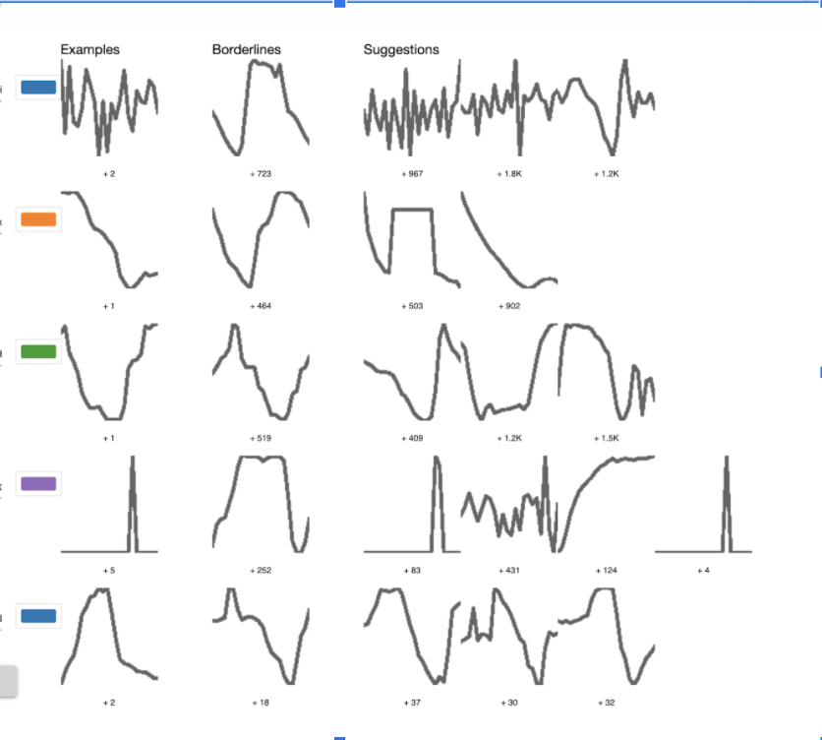
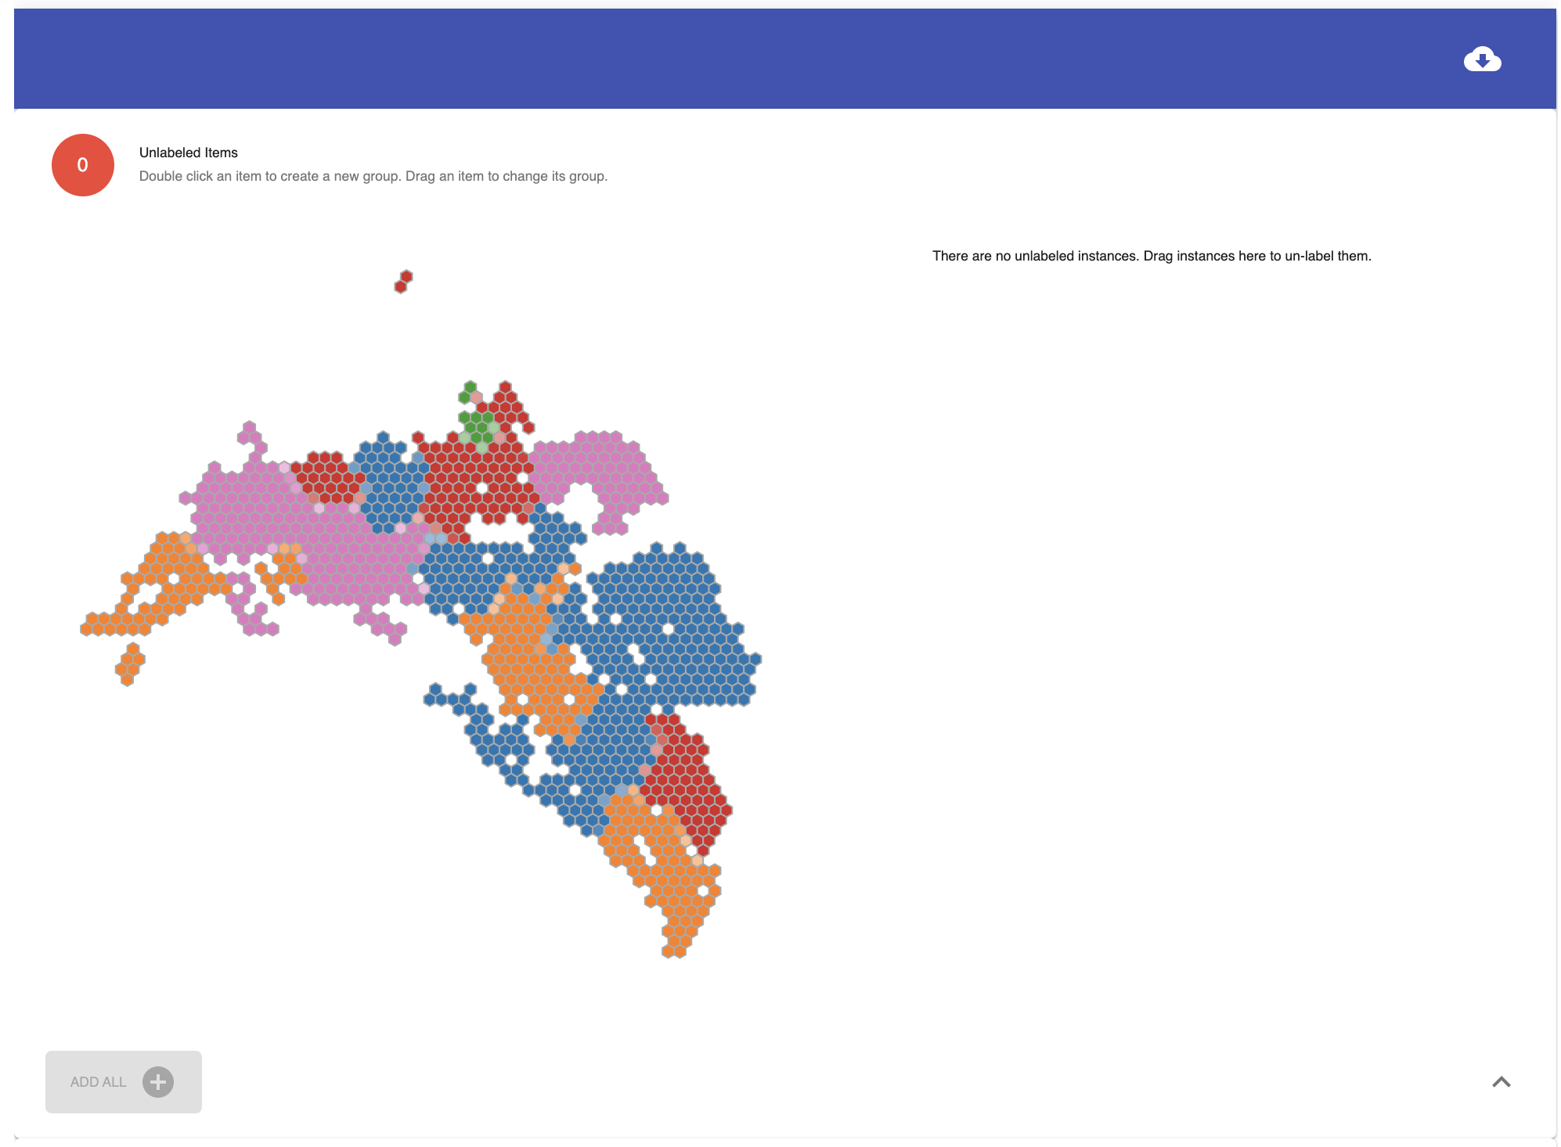
CHISSL labels
Utilized the CHISSL tool to find common patterns in the data, which allowed the team to label instances

Slide 30
ML Models
Summer Occurrence
Controlled Summer
Zone Temperature
Controlled Winter
Override Release
Constant
Zone Airflow
Hunting
Override
Normal Operation

Slide 31
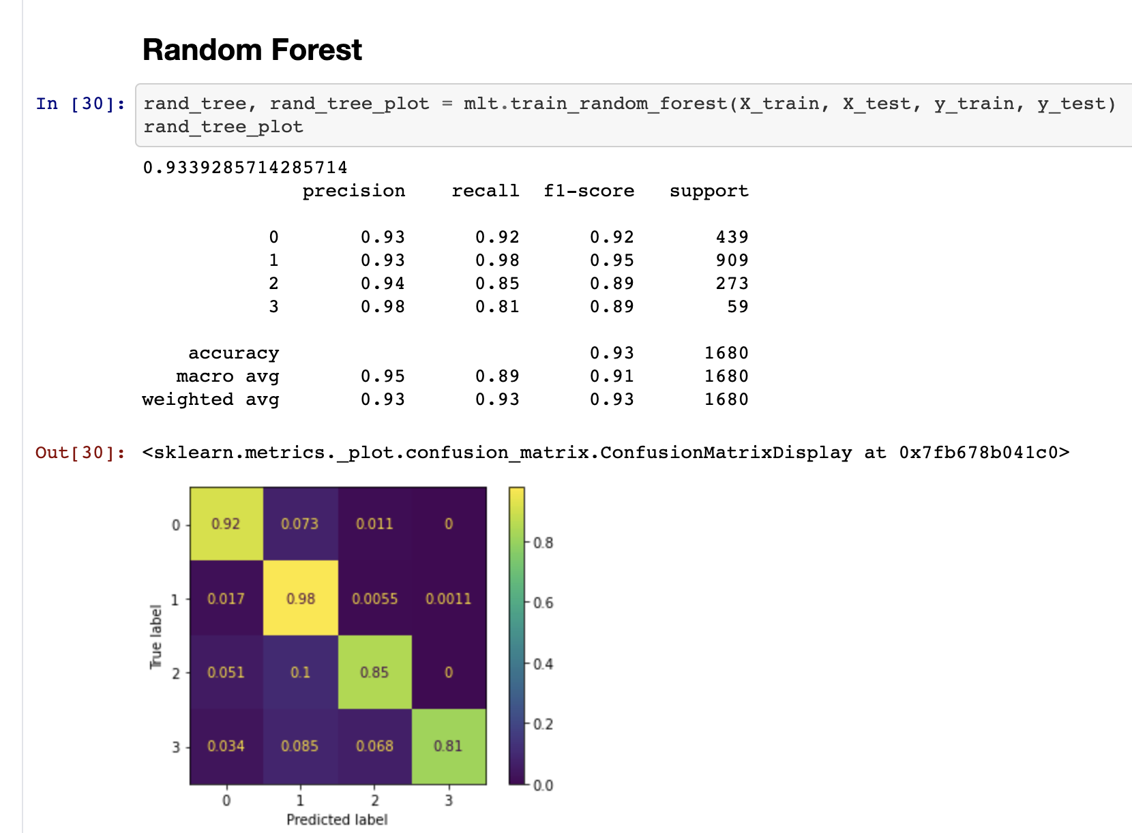
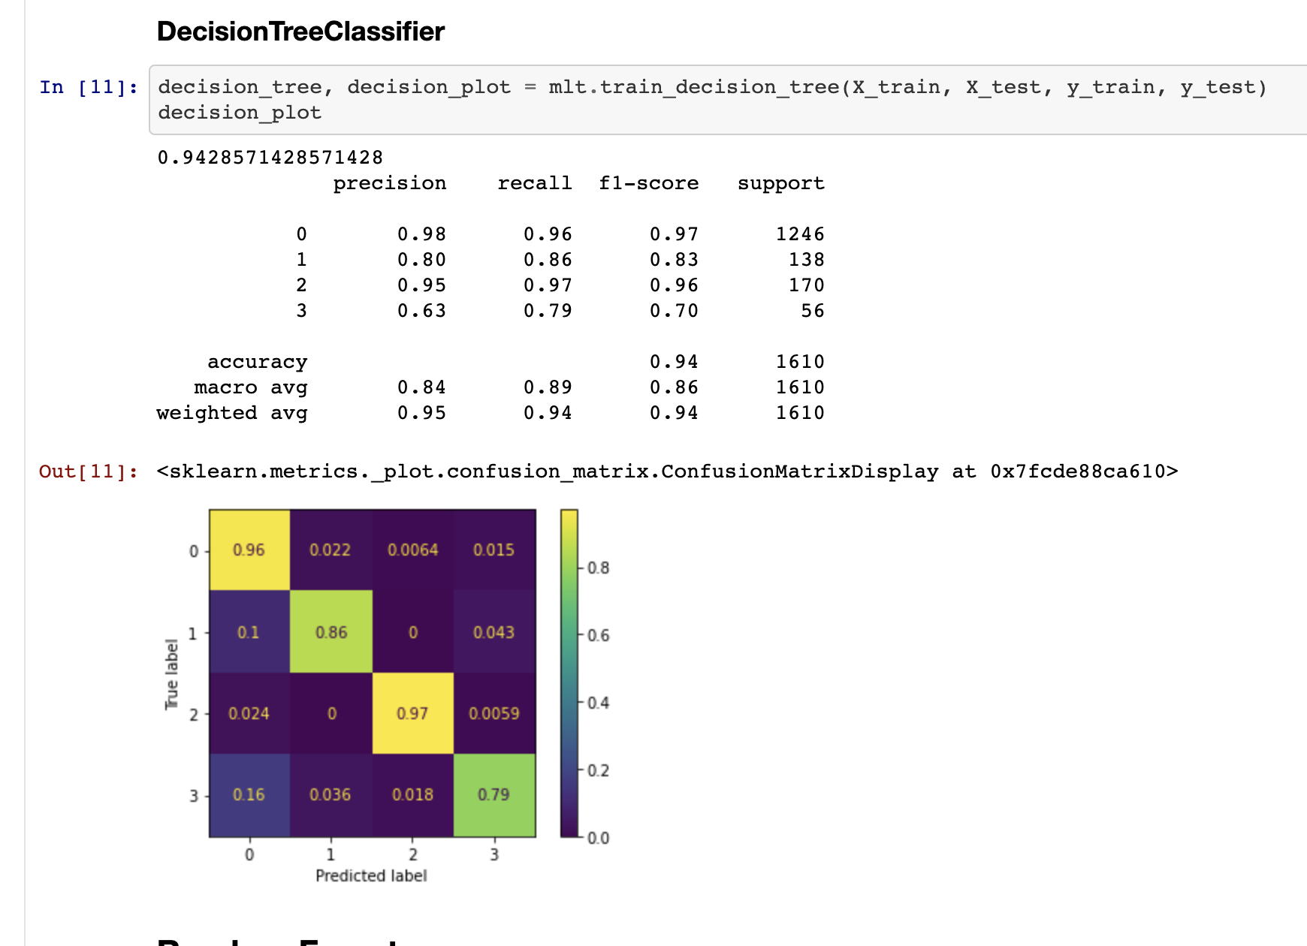
ML Models
Zone Temperature
Zone Airflow

Slide 32
ML Pipeline

Slide 33
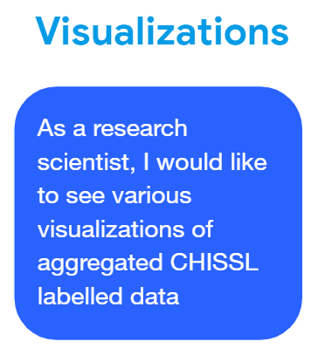
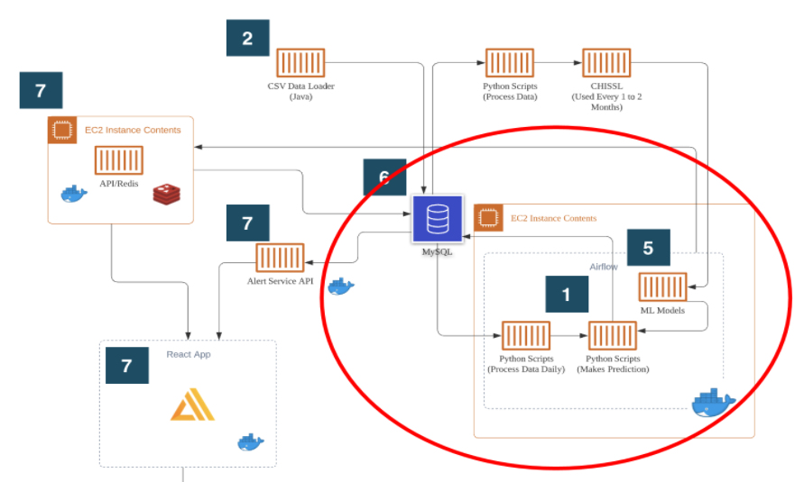
Implementation
1. Produce daily prediction data and store in MySQL.

Slide 34
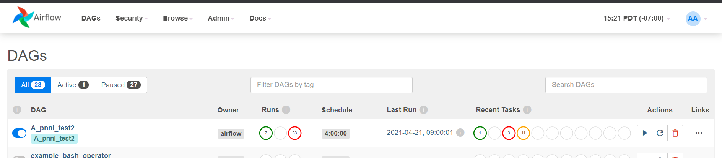
Implementation
2. Deploy Airflow in Docker

Slide 35
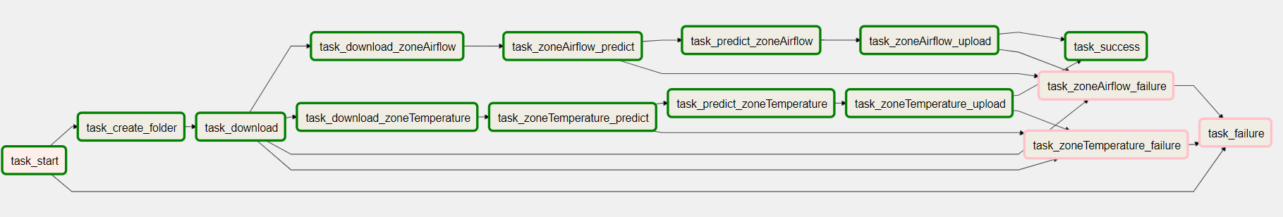
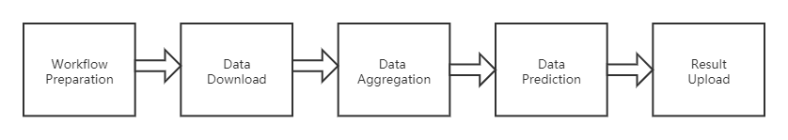
Workflow in Airflow

Slide 36
Testing & Quality Control
1. Fixed timezone problem
2. Fixed Airflow execution interval problem
3. Redesigned the DAG in Airflow
4. Improved error logging system

Slide 37
Backend APIs

Slide 38
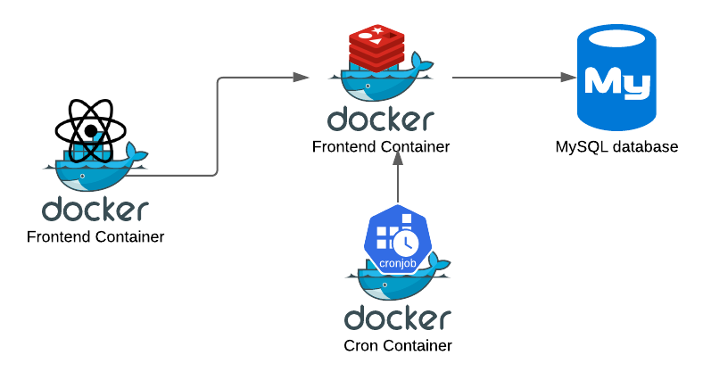
Predict Service API
GET http://localhost:5000/range/temperature/2021-03-16/2021-03-17
GET
http://localhost:5000/day/temperature/2021-03-16

Slide 39
Alert Service
Framework: Spring + Spring MVC + MyBatis
Architecture: Microservice
Supports CRUD operations on all tables of Nominalized Database and In-memory Database (Fully Mapped)
Customize the running time and frequency of timed tasks
Freely add new cron job
Define execution time using Cron expressions
Use embedded H2 database for data caching to improve response speed

Slide 40
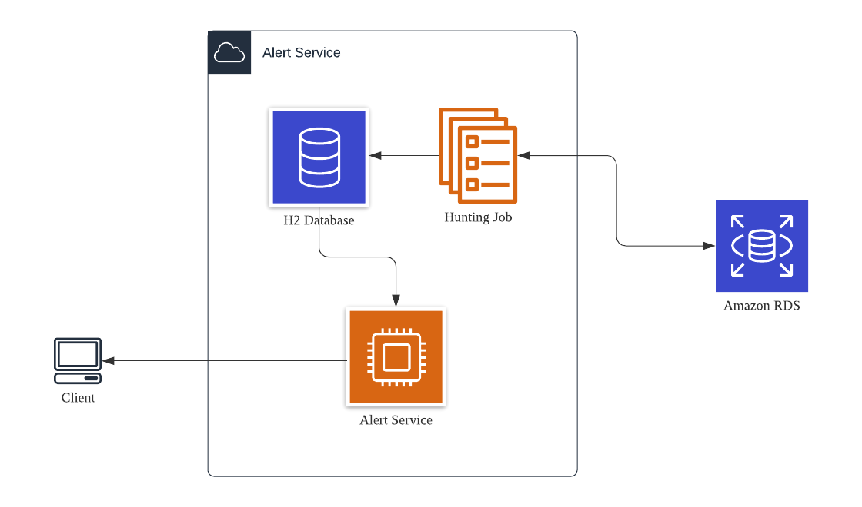
Alert Service Architecture

Slide 41
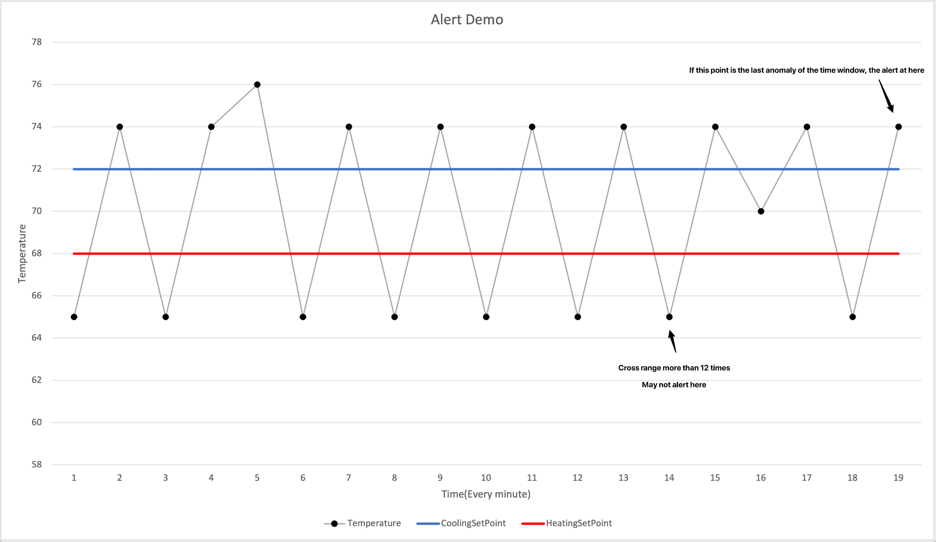
Alert Service
Crossing the normal area will be considered as an abnormal state

Slide 42
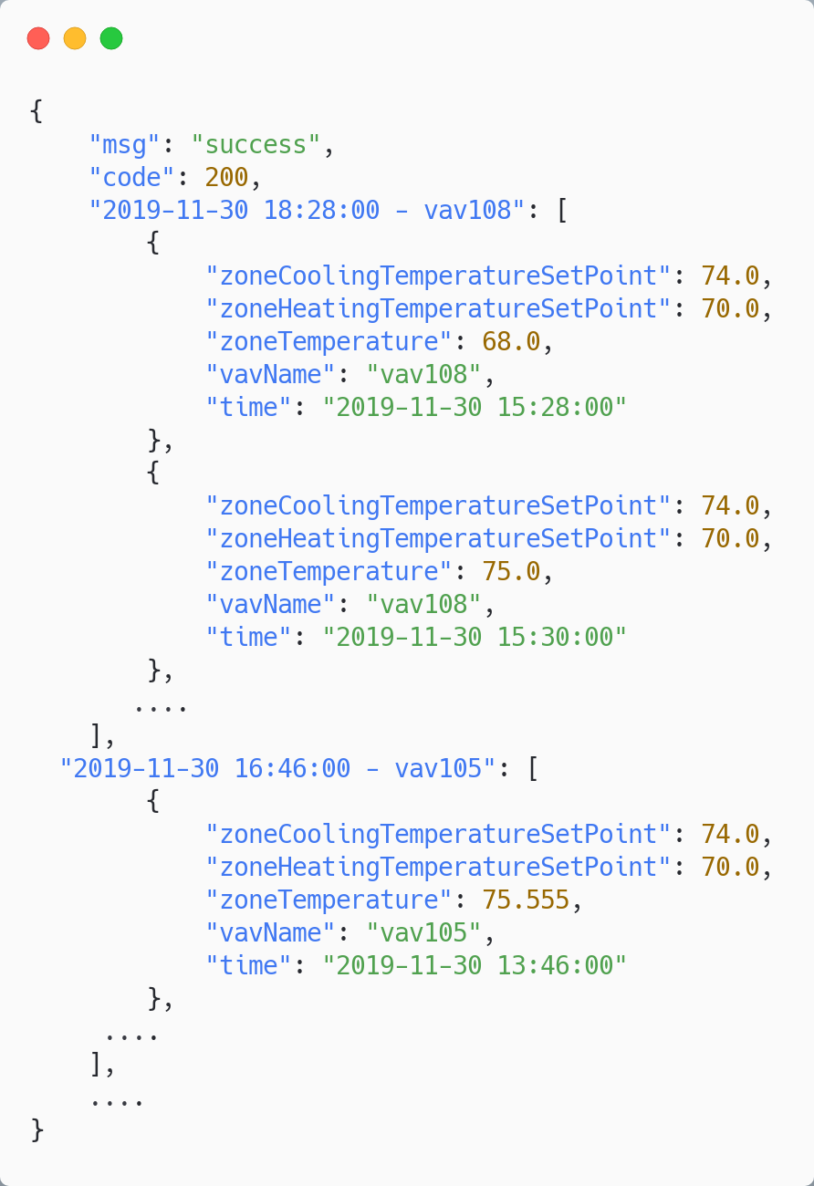
Alert Service - API Description
GET hunting/hunting/today :
The API does not require any additional parameters to be passed in and the return value will be provided as a json.
Each request performs a database query, but is extremely efficient because it uses the In-Memory database.
Swagger can be used for further insight.

Slide 43
User Interface: Grafana + React

Slide 44
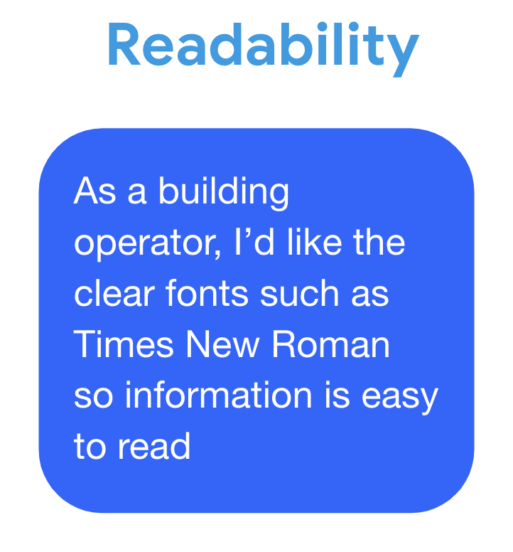
Frontend
Demo
Timeliness
Visualizations
As a building operator, it is important to see the data in a timely manner to make decisions on the operating units within the building
As a research scientist, I would like to see various visualizations of aggregated CHISSL labelled data

Slide 45
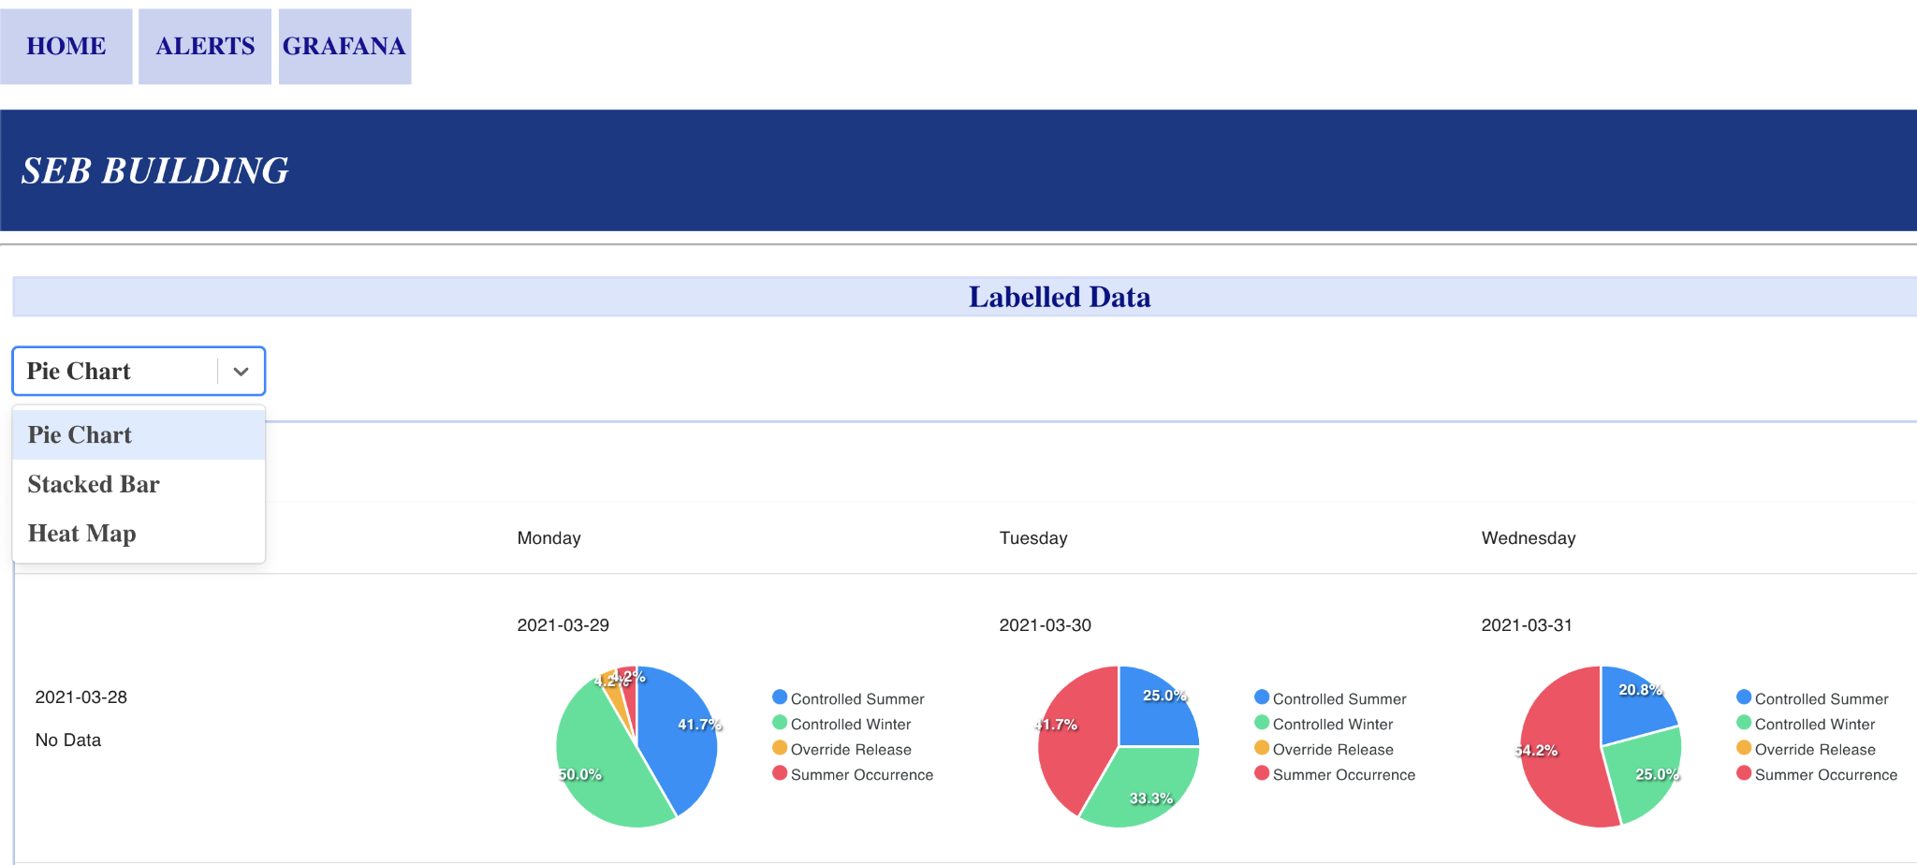
Frontend Team

Slide 46
Handoff Files
Files for handoff are located here: https://github.com/PNNL-Project/

Slide 47
Questions + Feedback

